Slide 1
Update on the Pathogenesis and Treatment of CSCR
Thomas M. Walent O.D.
Optometry Resident – VAMC
Wilkes-Barre, PA
March 30, 2012

Slide 2
Case History
March 3, 2005
41 W/M reports acute visual distortion OD x 1 week
More noticeable with near objects than far
(-)Ocular Hx, (+)Systemic hx allergic rhinitis, joint pain
Examination:
VAsc : OD 20/20, OS 20/20; 20/20 OU near with distortion
Entrance tests, slit lamp, IOP unremarkable
Amsler grid: (+)metamorphopsia OD, unremarkable OS
DFE: OD (+) pigmentary changes (-)fluid (-)thickening
Tenative diagnosis – old CSCR
Referred to retinal specialist – March 8, 2005 (FA and OCT)
Confirmed findings of past episode CSCR (pigment atrophy), suggested observation.

Slide 3
3/8/05 – Distortion OD after heated argument
Amsler (+)MM OD
OCT – serous RD
Referral to Retinal MD
3/13/07 – retinal specialist
FA – (+)CSCR OD – “old”
OCT (+) serous RD
Observation, denies steroids
3/16/09 – entered school “stressful”, difficulty at near
Prespbyopia OU - NVO
Pigment OD>OS
OCT thickening OD (-)fluid
11/6/09 – Exam WNL, no complaints
6/30/10 – Visual distortion OU
Amsler (+)MM OD
OCT (-) fluid, no changes
1/19/11 - Distortion and blind spot OS – sudden onset, “stressful”
Amsler (+)MM OD, (+) wedge shaped defect Temp
OCT (+) thickening OD, (+) serous RD OS
Denies steroids, inhaler???
Refer Retinal MD
4/12/11 – Retinal Specialist
RPE Atrophy OD>OS
(+) Serous RD OD, flat OS
Observation
Denies steroids – inhaler? Bursitis?
6/28/11 – Repeat findings
9/13/11 – Retinal Specialist
Distortion OS c central blind spot
OCT (+) persistent RD OD, (+) serous RD OS
Repeat injections for bursitis, inhaler for asthma
Observation, d/c steroids
10/4/11 – Getting better, d/c inhaler, hasn’t had injection
OCT (+) Serous RD OD, flat OS
Pt “I need this to STOP!”

Slide 4
Central Serous Chorioretinopathy (CSCR)
Pt diagnosis:
OD: Chronic recurrent CSCR
OS: Chronic resolving CSCR
What DO we know about CSCR?
What do we NOT know about CSCR?
Is there anything that can be done to help our pt?
Diagnostic tools
Pathophysiology
Potential treatments

Slide 5
What we do know…
Central Serous Chorioretinopathy (CSCR) –
Exudative chorioretinopathy characterized by a serous neurosensory retinal detachment (RD) with or without an associated detachment of the retinal pigment epithelium (RPE).
Retinopathy misnomer, actually choroidopathy
Fourth most common “retinopathy” after:
Age Related Macular Degeneration (ARMD, AMD)
Diabetic Retinopathy (NPDR/PDR)
Branch Retinal Vein Occlusion (BRVO)

Slide 6
Demographics
Most cases are seen between ages of 20 – 50 yrs
Mean age 41
Pts older than 50 had bilateral disease, systemic HTN, and exposure to corticosteroids
Men : Women = 6:1
More commonly seen in Asians and Whites
However CSCR tends to be more aggressive African Americans → greater sympathetic activity
Various systemic associations

Slide 7
Systemic Associations
Stress Hormones and Physiological Anxiety
Endogenous Corticosteroids and Epinephrine
*Type A Personalities*
Exogenous glucocorticoid administration
Untreated high blood pressure
Pregnancy
Due to neuroendocrine and hemodynamic changes with increase in stress and anxiety
Sildenafil (Viagra)

Slide 8
High levels of stress and anxiety hormones – endogenous, serum and urinary
Corticosteroids - cortisol
Cushing’s Syndrome – 5%
Epinephrine
Obstructive Sleep Apnea
Systemic HTN
Type A Personality – quickness to anger, competiveness, need to be in control
Earliest indentified
Most recognized risk factor
40x cortisol, 4x epinephrine with increase HTN

Slide 9
Exogenous corticosteroids
Administered intramuscularly, topically, inhaled, intraocularly, etc.
Related conditions: asthma, autoimmune disorders, dermatological conditions, allergic rhinitis, degenerative disc disease requiring epidural steroids, organ transplant pts, macular edema, etc…
Single dose of Kenelog for tx macular edema BRVO
52% of pts with CSCR

Slide 10
Classifications
Typically a “benign, self-limiting disease with detachment resolution within 3 months”, however it has a tendency to re-occur with decreased visual function.
Acute – single episode (51%), no treatment
Chronic – (49%)
Resolving chronic – subretinal fluid resolves, comes back
Recurrent chronic – subretinal fluid remains → chronic RD
Serous elevation with associated areas of RPE atrophy
Treatment required???

Slide 11
Clinical Presentation
Acute onset of central scotoma, metamorphopsia, and micropsia
Refractively may have small hyperopic correction
Decrease in contrast sensitivity
Increase in macular photostress test recovery time
Biomicroscopy
Serous macular neurosensory retinal detachment (RD)
RPE detachments (PED’s)
Subretinal deposits (“dots”) in the area of detachment
Pigment mottling and atrophy

Slide 12
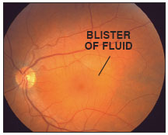
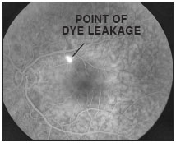
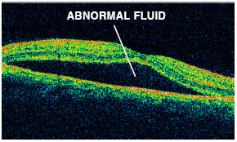

Slide 13
Differential Diagnosis
Choroidal Neovascularization
Exudative AMD
Multifocal Choroiditis
Degenerative Myopia
Angioid Streaks
Idiopathic Serous PED
Vogt-Koyanagi-Harada Disease
Macular Hole
Optic Nerve Pit
RPE Dystrophy (ex. Best)
Malignant HTN
Choroidal Tumors
Hemangioma
Metastasis
Melanoma
Acute Lymphocytic Leukemia

Slide 14
What We Do Not Know
Risk factors and associated conditions are not fully understood and none are significant predictors.
CSCR has a spectrum of presentations with diffuse retinal dysfunction and variations.
Pathophysiology is unclear!
Hypothesis: Choroidal vs. RPE?
Therefore, treatment of CSCR is targeted anatomically
Advent and advancements in FA, ICGA, and OCT help to improve understanding of anatomical structure primarily involved in determining the development of the disease

Slide 15
Choroidal Dysfunction Theory
Don Gass theory – permeability of choriocapillaris due to damage of overlying RPE → PED → serous RD
ICG-V revealed diffuse hyperpermeability around active leakage site but NOT with FA
Hyperpermeability of choroid not RPE
Choroidal hyperpemeability → serous PED→ rip in RPE → RPE leakage → serous RD
Alterations in choroidal circulation → ischemia → leakage
Dilation of capillaries and draining vessels, following localized delay in arterial filling → choroidal hyperpermeablility in area of damaged RPE

Slide 16
RPE Dysfunction Theory
Undefined insult of the RPE (even 1 single cell) causes a reverse in fluid movement in the chorioretinal direction → leakage of fluid into subretinal space → serous RD

Slide 17
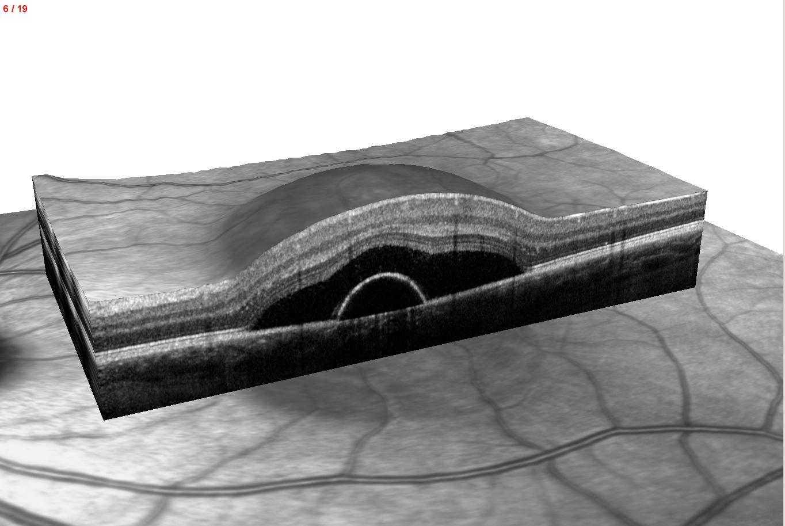

Slide 18
Imaging
Fluorescein Angiography (FA)
Shows expanding point of leakage under serous RD without subretinal neovascularization
Leaks present in 95% of cases, <10% in the fovea, most located 0.5-1.5mm away from center fovea
Chronic CSCR often display multiple leaks
Leakage site – HYPERfluorescent
Classic “smoke stack” leak – only seen 7% time!

Slide 19
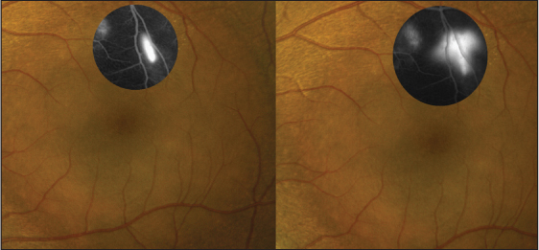

Slide 20
Imaging
Optical Coherence Tomography (OCT)
PED found with both active and inactive CSCR within or outside areas of serous RD
Diffuse RPE involvement combined with multiple small PEDs in the macula and along arcades in 1/3 of all eyes studied
Increased choroidal thickness (505μm vs 272μm)
SD-OCT with Enhanced Depth Imaging
95% with tiny defect in RPE within the PED
Defects correspond to leakage on FA
Defects in RPE allow fluid to sub-retinal space → RD

Slide 21
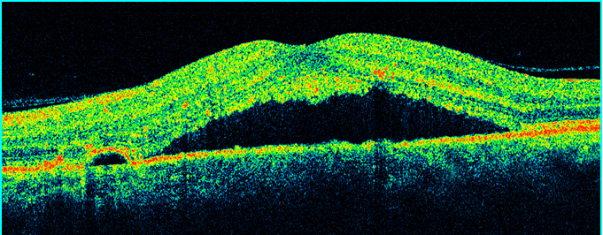
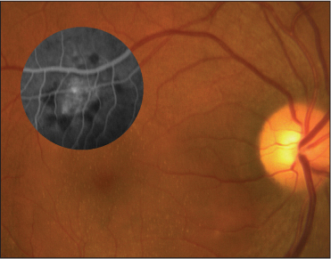

Slide 22
Imaging
Indocyanine Green Angiography (ICGA)
Helpful in describing abnormalities in choroidal circulation – hypothesis of primary pathology
63-100% of cases had filling delays, this congestion after ischemia →choroidal hyperpermeability
Shown that RPE leakage only occurs in areas of choroid capillary or venous congestion shown on ICGA
Area of leakage = HYPOfluorescent

Slide 23
Imaging
Fundus Autofluorescence (FAF)
Provides functional imaging of fundus though stimulated emission of light from lipofuscin →indirect measure of metabolic activity of RPE cells
At RPE, build up of lipofuscin related to phagocytosis of PR outer segments
Hypothesized that material on outer surface of elevated retina in CSCR represent accumulation of PR outer segments
65% of CSCR cases have dot-like precipitates and subretinal yellow material – FAF useful in prognosis

Slide 24
Acute CSCR – high AF correspond to areas of RD
Chronic CSCR – mixed increased/decreased AF - atrophy
FAF useful in identifying pts that would not benefit from laser treatment
Those with reduced AF at central macula indicate atrophy → not suitable for laser treatment
Granular and confluent AF within macula associated with increased age - predictors of lower VA
Take home: FAF combined with OCT can lead to more accurate diagnosis of chronic CSCR than FA

Slide 25
ICGA
FAF

Slide 26
Treatment Options
Prognosis of CSCR is good, 80-90% of cases resolve spontaneously in 3 months.
If pt is on exogenous corticosteroids they should be tapered and discontinued.
Active treatment should be considered:
Pt d/c steroids, condition doesn’t improve in 2 months
Pt unable to d/c steroids
Previous episodes left with residual deficit or visual symptoms that significantly affect activities of daily living

Slide 27
Treatment Options
Laser Photocoagulation (LP)
Changes the ability of RPE to act as barrier to diffusion
In CSCR, subretinal fluid has higher protein content, LP allows fluid and protein into choroid
Laser debridement of local RPE cells allows adjacent RPE to take over their function at site of lesion
Shown to decrease recurrence rate (34%) and decrease length of detachment by 2 months
No improvement in VA, used for symptomatic relief and encouragement of reattachment
Causes collateral damage – symptomatic scotomas, CNVM

Slide 28
Treatment Options
Photodynamic Therapy (PDT)
Verteporfin (Visudyne)
Offers more precisely directed alternative to LP; directed at pathological hyperpermeable choroidal microcirculation seen on ICGA
Vascular remodeling → decreased permeability and termination of focal RPE leakage
Shown to resolve symptoms, serous RD and improve VA
However, less effective in eyes WITHOUT hyperfluorescence seen on ICGA

Slide 29
Performed under “Treatment of ARMD with PDT” (TAP) protocols with reports of complications: RPE changes, choriocapillary hypoperfusion, and CNVM
Half dose Verteporfin (3mg/m²) – improvement in retinal function and VA, especially without PED
Shown effective even at lower dose of 30%
Low-fluence (25 J/cm² @ 300mW) – less choriocapillaris damage, reduction in serous RD and increased VA in 79-91% pts.
One study indicated no effective difference in half dose PDT and LP, with faster resolution in PDT group

Slide 30
Treatment Options
Intravitreal Bevacizumab (Avastin)
Anti-vascular endothelial growth factor (VEGF), used commonly with wet AMD
VEGF has role in vascular permeability by changing tight junctions and inducing vascular fenestrations
May not affect underlying condition of CSCR but rather tight junctions only
Studies show improvements in VA, serous RD resolution and improvements in RPE leaks but with mixed results
Subretinal granular deposits from phagocytosis of photoreceptor segment that accumulate after RD could prevent anti-VEGF from working in chronic cases.

Slide 31
Treatment Options
Acetazolamide (Diamox)
Carbonic anhydrase inhibitor
Studies demonstrate a tapering dose of acetozolamide over 6 weeks shortened the time of clinical resolution without improving VA or preventing recurrence rate
May be useful in pts in need of accelerated resolution
ex. Monocular pts
Side effects: paresthesias, nervousness, gastric upset; contraindicated with sulfa allergy

Slide 32
Treatment Options
Ketoconazole (Nizoral)
Antifungal and adrenocorticoid antagonist
600mg / day for 4 weeks then 200mg / day for 4 weeks
Reduced urinary cortisol levels in all pts
Did not show improvement in VA or resolution of serous RD

Slide 33
Treatment Options
Mifepristone (Mifprex)
RU 486 “The Abortion Pill”
High affinity glucocortioid and progesterone antagonist
Small study: 200mg per day x 90 days
Significant resolution of serous RD, PED and VA
Drawbacks: high cost of treatment - $200 per 200mg dose, side effects
Warrants further investigation

Slide 34
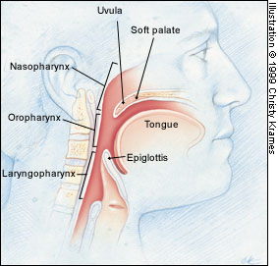
Treatment Options
Resolution of obstructive sleep apnea
Observational case reports have shown resolution of CSCR after treatment of obstruction SA
One study 22% of 56 pts with CSCR suffered from SA
Clinicians should consider this diagnosis in pts with CSCR and refer when appropriate

Slide 35
Conclusion
Greater understanding of CSCR has changed initial beliefs that it was a benign condition affecting young men with almost complete resolution.
Improved diagnostic modalities have allowed clinicians to evaluate with increased sensitivity.
Although natural history is good, pts do suffer visual disability for a period of time, many of which have high visual demands.

Slide 36
Treatment should therefore be considered after 3 months if evidence of ongoing foveal leakage in recurrent chronic CSCR or in an acute case with signs of chronic CSCR alterations.
In the near future, clinicians will have a variety of interventions at their disposal to resolve signs and symptoms of disease.

Slide 37
Caccavale A, Romanazzi F, Imparato M, Negri A, Morano A, Ferentini F. Central serous chorioretinopathy: a pathogenetic model. Clin Ophthalmol. 2011;5:239-43. Epub 2011 Feb 20.
Colucciello M. Central Serous Retinopathy. Retinal Physician. September 1, 2008
Colucciello M. Central Serous Retinopathy Update: Daignostic and Treatment Highlights. Retinal Physician. September 1, 2008
Gemenetzi M, De Salvo G, Lotery AJ. Central serous chorioretinopathy: an update on pathogenesis and treatment. Eye (Lond). 2010 Dec;24(12):1743-56. Epub 2010 Oct 8. Review.
Nielsen JS, Weinreb RN, Yannuzzi L, Jampol LM. Mifepristone treatment of chronic central serous chorioretinopathy. Retina. 2007 Jan;27(1):119-22.
Nielsen JS, Jampol LM. Oral mifepristone for chronic central serous chorioretinopathy. Retina. 2011 Oct;31(9):1928-36.
Ross A, Ross AH, Mohamed Q. Review and update of central serous chorioretinopathy. Curr Opin Ophthalmol. 2011 May;22(3):166-73. Review.
Shah SP, Desai CK, Desai MK, Dikshit RK. Indian Steroid-induced central serous retinopathy. J Pharmacol. 2011 Sep;43(5):607-8.

Slide 38
Thank You!
twalentiii@gmail.com
Thomas.Walent@va.gov

